Slide 1

Angular Part 1 – Introduction Wednesday, November 29, 2023

Slide 2


Agenda
Preliminary Study Structure
Angular Introduction
Installation
Create Default App Component
Files and Directory Structure Explained
Small Exercise to Echo What You Typed & Background Changed

Slide 3
Preliminary Study Structure Derived from https://www.koderhq.com/tutorial/angular/
Angular Part 1 – Introduction
Angular Part 2 – Data and Event Binding: Learn 2-way data binding, string interpolation and how events are handled and also will look at Angular ngIf, if, ngFor, for, and ngModel directives.
Angular Part 3 – Custom Data and Event Binding: Learn how to communicate between parent and child components with custom property binding and the @Input and @Output decorators.
Angular Part 4 – Custom Directives: Learn how to create custom directives
Angular Part 5 – Services and Dependency Injection: Learn how common services are injected into component.
Angular Part 6 – Pipes – Learn how to transform output.
Angular Part 7 – Routing: Learn how to navigate between HTML pages.
Angular Part 8 – Reactive Forms: Learn how to handle user input such as data validator.
.Net & Angular Part 1 - .Net Introduction.
.Net & Angular Part 2 – Entity Framework: Learn .Net database framework.
.Net & Angular Part 3..n – TBD: Learn how Angular frontend interfaces with .Net backend with Entity Framework

Slide 4
Angular Part 1 - Introduction
Angular is a front-end Javascript framework, component-based, for creating single-page applications
Developed by Google
Initial Released in 2016
Home page @ https://angular.io/

Slide 5
Installation
Download and install Visual Studio Community version @ https://visualstudio.microsoft.com/free-developer-offers/ Remember to select ASP.NET and .NET Framework project and item templates
Angular cli uses Node.js under the hood and thus we need to download and install Node.js @ https://nodejs.org/en/download
Install Angular: npm install -g @angular/cli
Install ESLINT extension from Visual Studio
Notes: In the case where the project needs ESLINT configuration file then the below commands will install and create .eslintrc.json -> npm i eslint --save-dev -> .\node_modules\.bin\eslint -- init -> Modify .eslintrc.json to include: "parserOptions": {"tsconfigRootDir": "__dirname", …

Slide 6
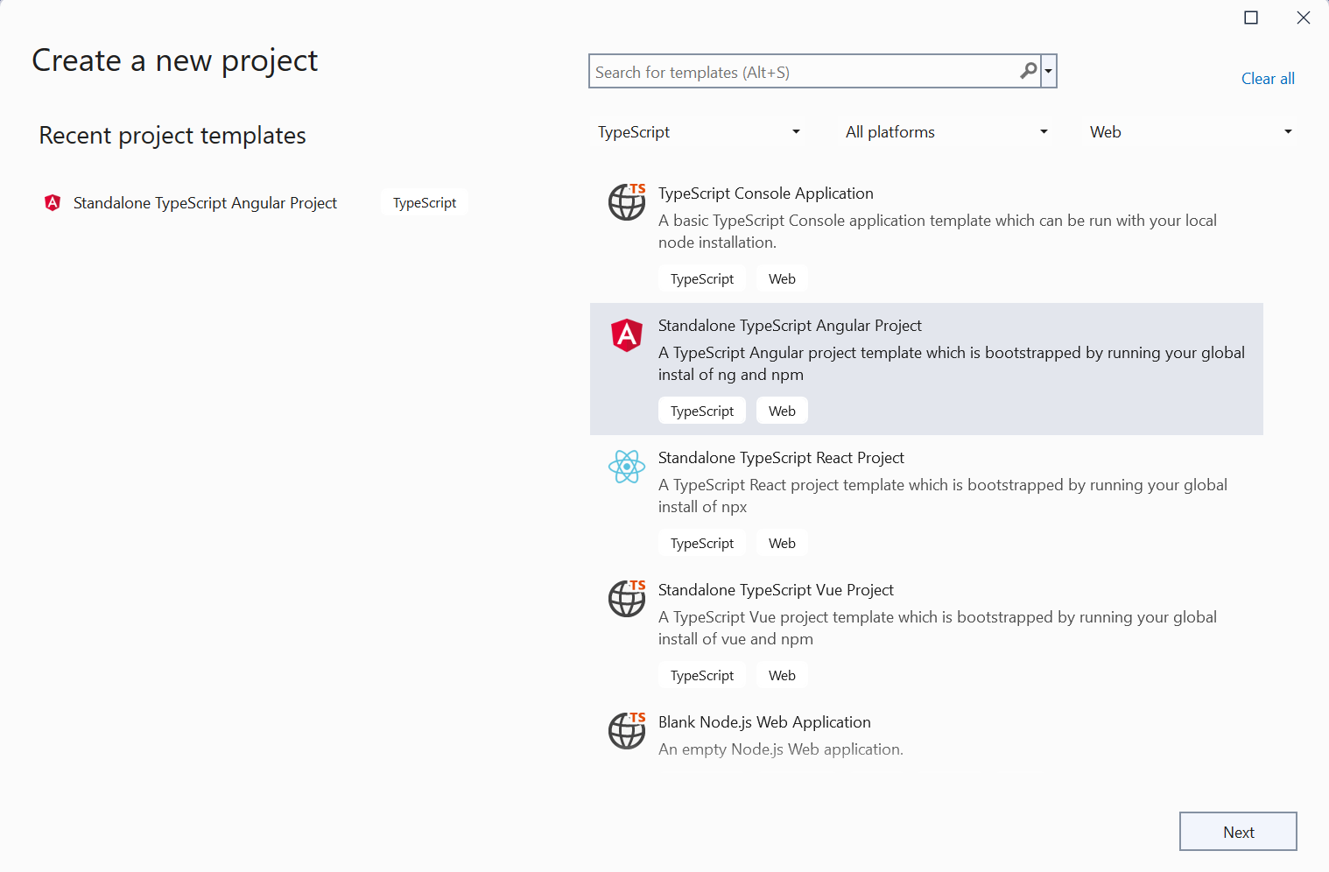
Create Default App Component

Slide 7
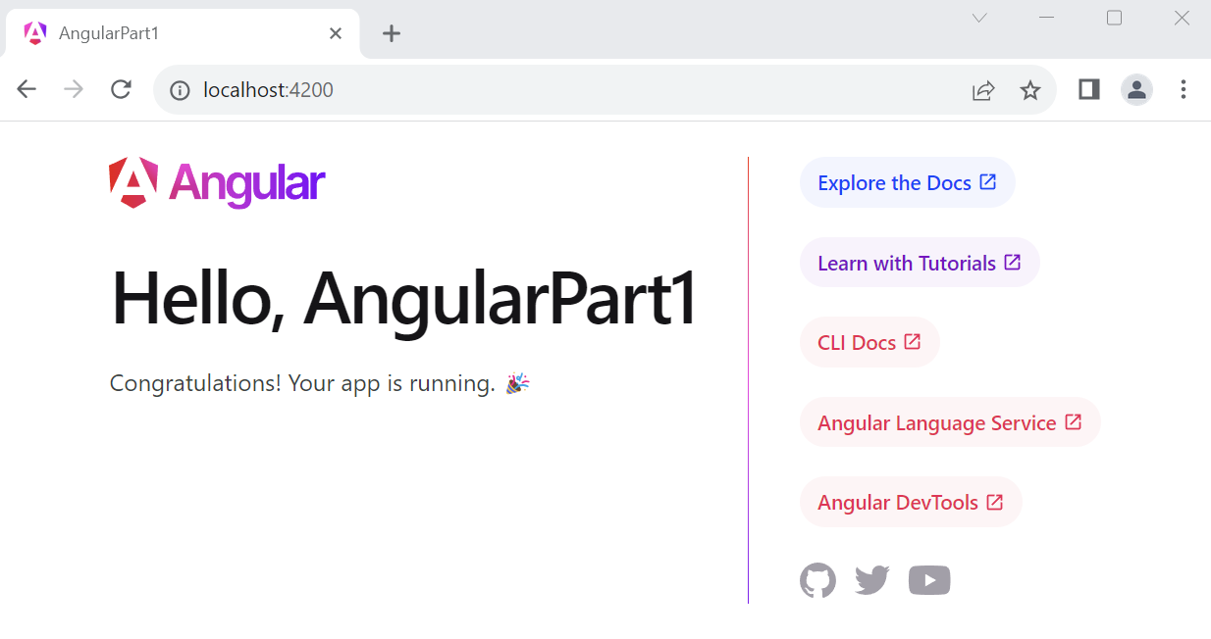
Create Default App Component

Slide 8
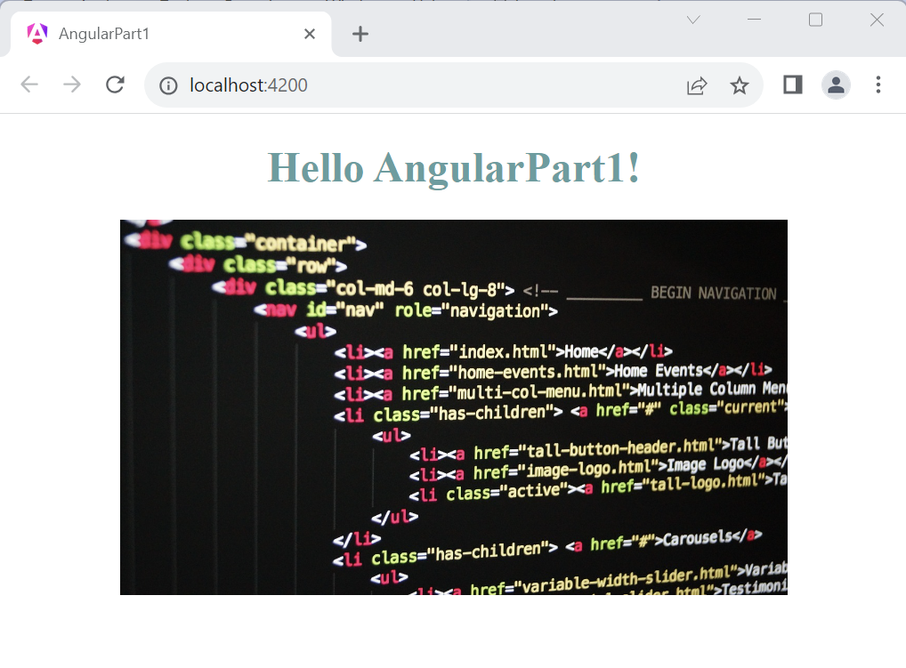
My 1st App After Modified app/app.component.html

Slide 9
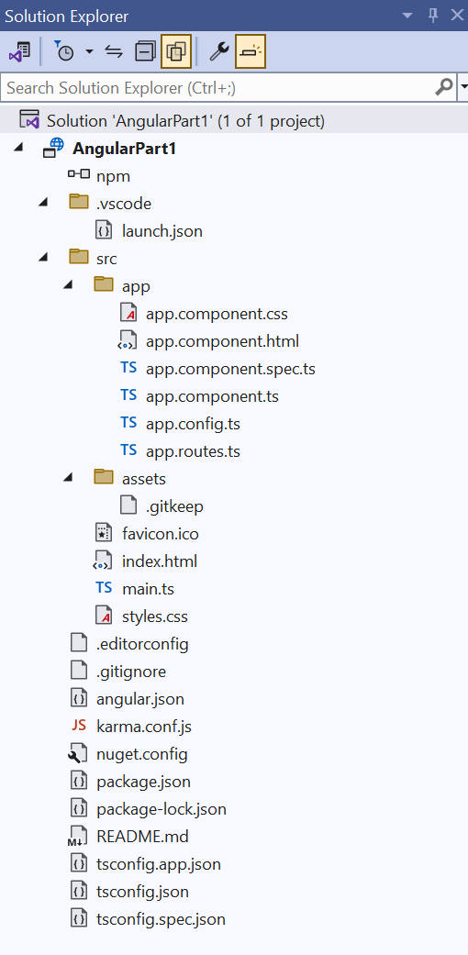
Files and Directories Structure Explained
File package.json contains (1) scripts to run ng, (2) run-time dependencies and (3) development dependencies. An example is below. The option poll in msec allows ng serve to poll for any updates on source files.
{
"name": "angular-part1",
"version": "0.0.0",
"scripts": {
"ng": "ng",
"start": "ng serve --host=127.0.0.1 --poll=200",
"build": "ng build",
},
"private": true,
"dependencies": {
"@angular/common": "^17.0.0",
"@angular/compiler": "^17.0.0",
"@angular/core": "^17.0.0",
"@angular/forms": "^17.0.0",
},
"devDependencies": {
"@angular/cli": "^17.0.1",
"@angular/compiler-cli": "^17.0.0",
"typescript": "~5.2.2"
}
}

Slide 10
Files and Directories Structure Explained
File angular.json contains the overall configuration such as global styles and scripts that get auto loaded during runtime. And preserveSymlinks set to true to indicate not to use the real path when resolving module during ng build.
{
"version": 1,
"newProjectRoot": "projects",
"projects": {
"AngularPart1": {
"sourceRoot": "src",
"prefix": "app",
"architect": {
"build": {
"builder": "@angular-devkit/build-angular:application",
"options": {
"outputPath": "dist/angular-part1",
"index": "src/index.html",
"browser": "src/main.ts",
"preserveSymlinks": true,
"polyfills": [
"zone.js"
],
"tsConfig": "tsconfig.app.json",
"assets": [
"src/favicon.ico",
"src/assets"
],
"styles": [
"src/styles.css"
],
"scripts": []
},

Slide 11
Files and Directories Structure Explained
File tsconfig.json contains typescript configuration such as strict mode to true to error uninitialized variable before use during compilation.
{
"compileOnSave": false,
"compilerOptions": {
"outDir": "./dist/out-tsc",
"forceConsistentCasingInFileNames": true,
"strict": true,
"noImplicitOverride": true,
"noPropertyAccessFromIndexSignature": true,
"noImplicitReturns": true,
"noFallthroughCasesInSwitch": true,
"esModuleInterop": true,
"sourceMap": true,
"declaration": false,
"experimentalDecorators": true,
"moduleResolution": "node",
"importHelpers": true,
"target": "ES2022",
"module": "ES2022",
"useDefineForClassFields": false,
"lib": [
"ES2022",
"dom"
]
},

Slide 12
Files and Directories Structure Explained
File index.html is a home page for the web site. The <app-root> tag is the place holder to display all content from the app component folder here.
<!doctype html>
<html lang="en">
<head>
<meta charset="utf-8">
<title>AngularPart1</title>
<base href="/">
<meta name="viewport" content="width=device-width, initial-scale=1">
<link rel="icon" type="image/x-icon" href="favicon.ico">
</head>
<body>
<app-root></app-root>
</body>
</html>

Slide 13
Files and Directories Structure Explained
File main.ts is a start program or main entry point to angular. It runs after the index.html is loaded and starts up the AppComponent and configuration appConfig.
import { bootstrapApplication } from '@angular/platform-browser';
import { appConfig } from './app/app.config';
import { AppComponent } from './app/app.component';
bootstrapApplication(AppComponent, appConfig)
.catch((err) => console.error(err));

Slide 14
Files and Directories Structure Explained
File app/app.component.css is style sheet for the app component. It overrides any CSS found in the global styles.css defined in angular.json.
h1 {
color: cadetblue;
}
File app/app.component.html is app component HTML. The {{ title }} is filled with title from the app.component.ts.
<div style="text-align:center">
<h1>
Hello World {{ title }}!
</h1>
<img width="500" alt="Web Development Study Group Logo" src="./assets/WebDevelopmentStudyGroup.jpg">
</div>

Slide 15
Files and Directories Structure Explained
File app/app.component.ts is the typescript app component. The @Component decorator provides configuration metadata/information that determines how the component should be used.
The standalone set to true to indicate that this component will manage its own dependencies via imports property. Less boilerplate such as NgModule in app.module.ts
The selector app-root defines how this component is embedded in HTML DOM.
The templateUrl and styleUrl signify that the template HTML and CSS will be used by the component.
import { Component } from '@angular/core';
import { CommonModule } from '@angular/common';
import { RouterOutlet } from '@angular/router';
@Component({
selector: 'app-root',
standalone: true,
imports: [CommonModule, RouterOutlet],
templateUrl: './app.component.html',
styleUrl: './app.component.css’
})
export class AppComponent {
title = 'AngularPart1';
}

Slide 16

Thank you
Sonny Hoang
sthoang62@gmail.com

